Slide 1
Advanced Systems Analysis and Design Moving into Implementation SOFT 30121 L17

Slide 2
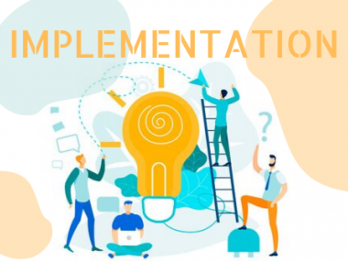
Moving into Implementation
RecoSystems Analysis and Design
Alan Dennis; Barbara Haley Wixom; Roberta M. Roth
2019
Chapter 12

Slide 3
Moving into Implementation
Objectives of Lecture 17
Be familiar with the system construction process.
Explain different types of tests and when to use them.
Describe how to develop user documentation.
SOURCE: RecoSystems Analysis and Design
Alan Dennis; Barbara Haley Wixom; Roberta M. Roth
2019
Chapter 5

Slide 4

The implementation phase
Doing a thorough job on the analysis and design phases is essential to a smoot and successful implementation phase
In industry, while programmers/developers are transforming program specifications into code, the systems analyst is designing a variety of tests, as well as finalising the system documentation and user documentation

Slide 5
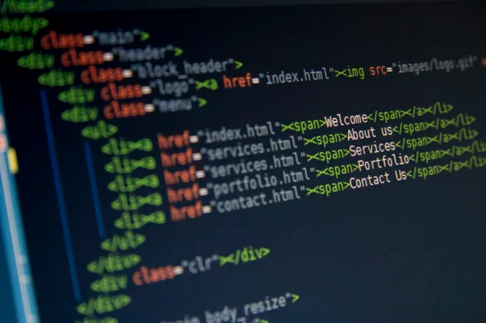
Managing the programming process
Tasks the project manager must do to manage the programming effort:
Assigning programming tasks
Coordinating the activities
Managing the programming schedule

Slide 6
Assigning programming tasks
Use cases that are related are grouped together.
These groups are then assigned to programmers on the basis of their experience and skill
It may be identified here that there is a mismatch between the skills of the team, and the skills needed to complete the project
The additional time needed for the team members to be trained/mentored should be considered.
After a point, the more programmers who are involved, the longer the system will take (as the need for coordination increases)
The best size is the smallest feasible programming team

Slide 7
Coordinating Activities
Communication is key!
Regular, brief meetings encourage the discussion of issues before they become problems
We’ll be running the labs after Christmas as “standups” to help you with this. In industry, these are often run every day
Standups are simple. Each member of the team answers 3 questions:
What did I work on yesterday?
What am I working on today?
What issues are blocking me?

Slide 8

Managing the schedule
Scope creep can become an issues at this stage. Scope creep occurs when requirements are added to the project after system design has been finalised. Any features added at this point should be carefully considered
Unnoticed day-by-day slippages can cause delays in the schedule. These minor delays can up! Communication between the programming team is important to watch these minor slippages.

Slide 9
Development Guidelines

Slide 10
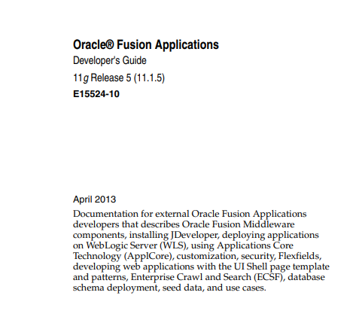
Guidelines
https://docs.oracle.com/cd/E29505_01/fusionapps.1111/e15524.pdf

Slide 11
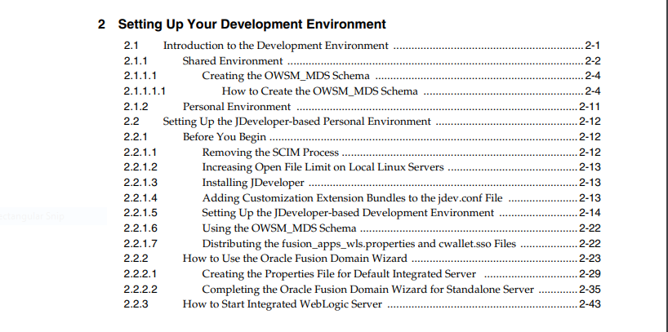
Guidelines
https://docs.oracle.com/cd/E29505_01/fusionapps.1111/e15524.pdf

Slide 12
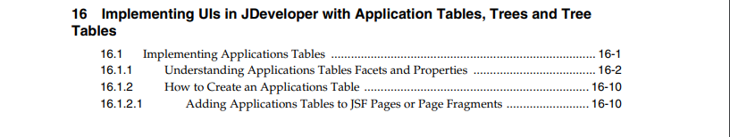
Guidelines
https://docs.oracle.com/cd/E29505_01/fusionapps.1111/e15524.pdf

Slide 13
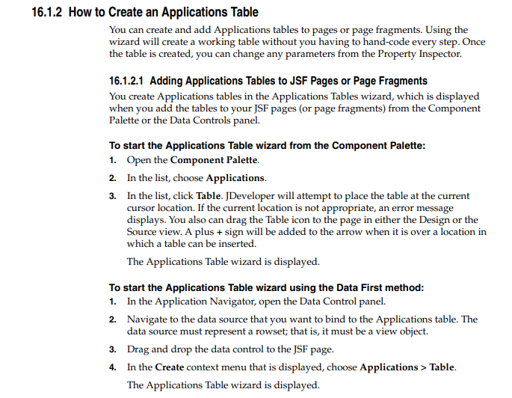
Guidelines
https://docs.oracle.com/cd/E29505_01/fusionapps.1111/e15524.pdf

Slide 14
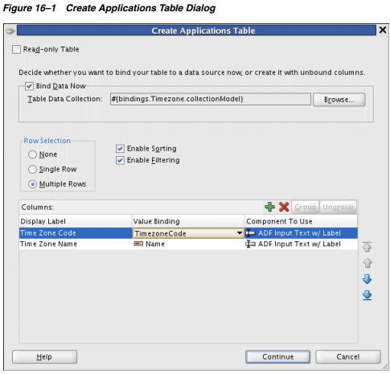
Guidelines
https://docs.oracle.com/cd/E29505_01/fusionapps.1111/e15524.pdf

Slide 15
Guidelines
https://docs.oracle.com/cd/E29505_01/fusionapps.1111/e15524.pdf
In development at scale, the setup in the IDE implements the guidelines.
We try and remove as much opportunity for developers to misconfigure their dev environments.

Slide 16
Coding Standards

Slide 17
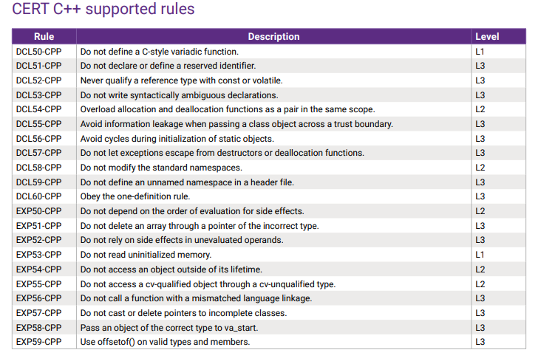
Standards
Synopsis Examples for C++

Slide 18
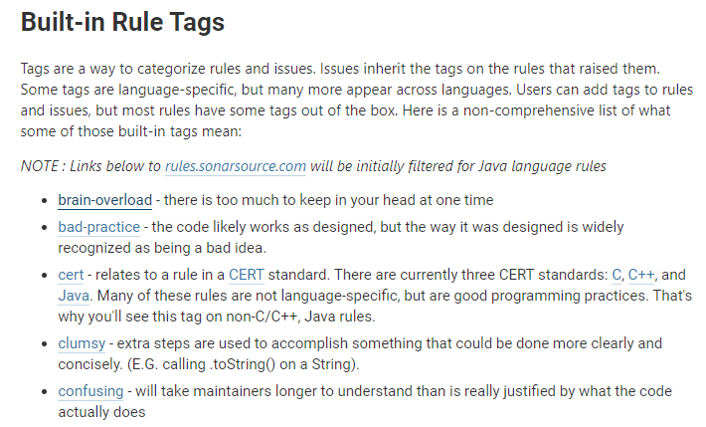
Standards
Tags in SonarQube

Slide 19
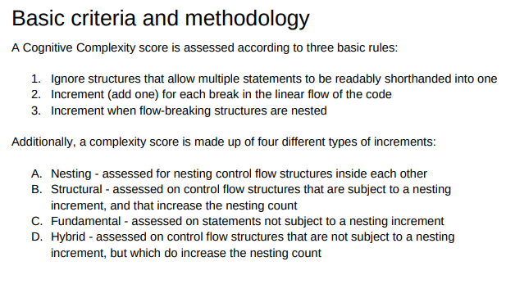
Standards
Brain Overload Tag in SonarQube
https://www.sonarsource.com/docs/CognitiveComplexity.pdf

Slide 20
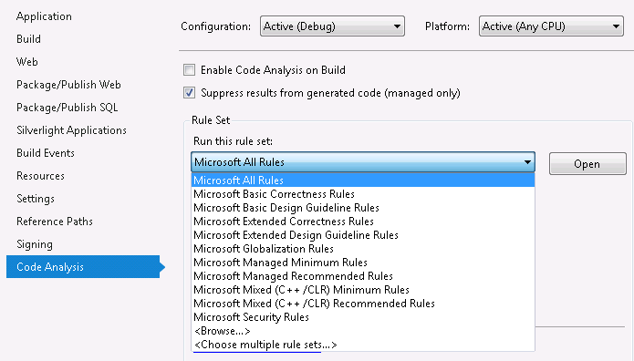
For example, use Visual Studio to enforce rules

Slide 21
Testing
Tests
Unit Tests – Does some small unit of code work?
Acceptance Tests – Does a module do what is required?
Negative Tests – Can the module be made to behave as is not intended?
Code Path Coverage – How much of the code is tested?
Build Acceptance Test – Does a new bit of code break the build?
Regression Test – Does a new bit of code, cause other code to break?
Performance Test – Does the code meet performance requirements?
Reliability Test – Can the code run for a long time without failures?

Slide 22
Testing hierarchy
Manual Acceptance Tests
Negative Tests
Unit Tests
Build Acceptance Tests
Regression Tests

Slide 23
Testing hierarchy
Beware Over Reliance on Manual Testing
Manual Acceptance Tests
Negative Tests
Unit Tests
Build Acceptance Tests
Regression Tests

Slide 24
Testing
Tests
Unit Tests - Developers
Acceptance Tests - QA
Negative Tests - QA
Code Path Coverage - Integration / Release Management
Build Acceptance Test – Integration / Release Management
Regression Test - Integration / Release Management

Slide 25
Developing/testing/production
It is important the programming effort is kept well organised
Files, data and programs are separated on the basis of their status of completion.
Programmers access and build files within the development area.
Then they deploy them into the testing area when they are “finished”
If they fail any tests they are sent back to development
Once any new features are tested and ready to support the new system, they are deployed to production.
Source control is crucial for this!

Slide 26
Testing
Often receives much less attention than it should!
Many professional organisations devote more resources to testing than to writing the software in the first place
Software is not considered finished until testing is complete

Slide 27
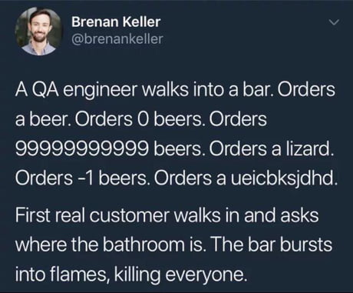
Test planning
A test plan defined a series of tests that will be conducted.
Each test should have a specific objective, and should describe a set of specific test cases to examine.
Automated testing tools enable comprehensive testing of all relevant test conditions.
In the example of an order quantity that must be between 10 and 100 units, test cases might include:
A valid value (15)
An invalid value too low (7)
An invalid value too high (110)
A non-numeric value: (asdf)
A non-sensical, but potentially valid data (43.2)

Slide 28
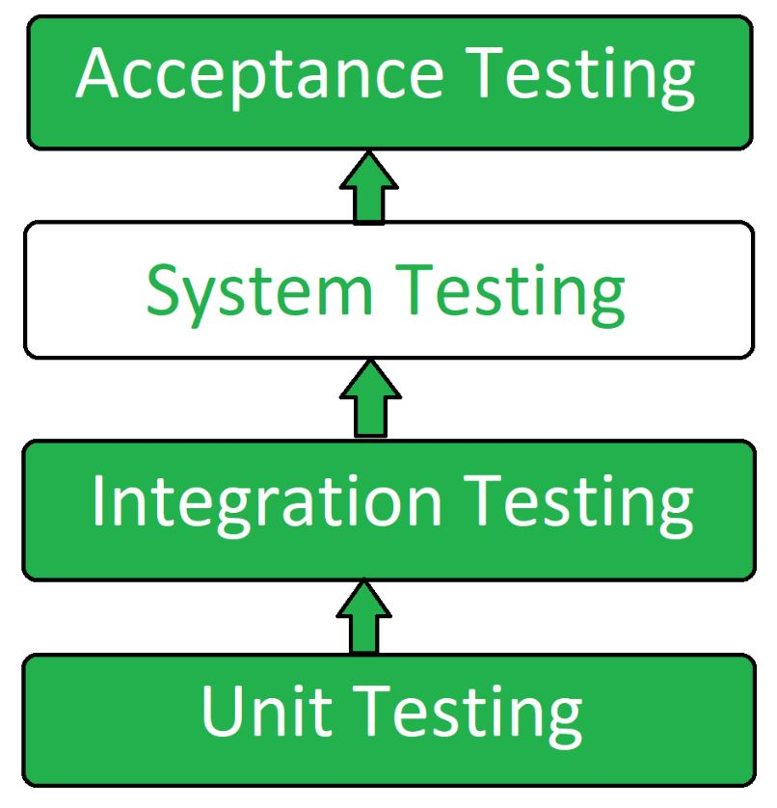
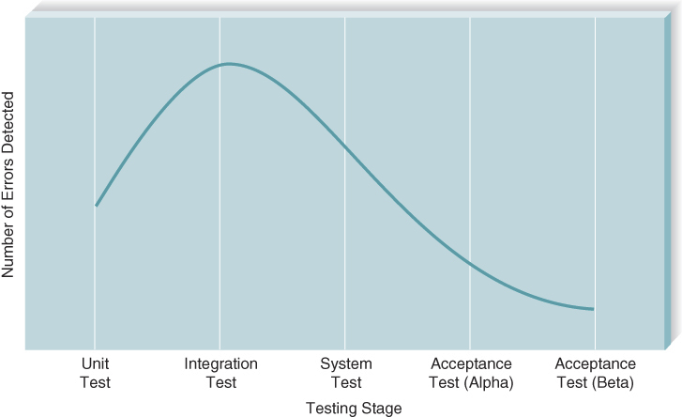
Four general stages of tests:
Unit tests
Integration tests
System tests
Acceptance tests
Generally, most errors are found during the integration and system testing:

Slide 29
Unit testing
Focuses on one unit
Normally an individual method/function/procedure
Commonly, this unit is isolated from unnecessary dependencies between other units or data spaces
Unit test frameworks such as Junit, NUnit and the C++ boost unit test framework are used to automate this
The more unit test coverage the better!

Slide 30

Integration testing
Assess whether a set of modules that must work together do so without error
They ensure that the interfaces and linkages between different parts of the system work properly
Unit tests should have passed at this point
Four approaches to integration testing:
User interface testing
Use scenario testing
Data flow testing
System interface testing

Slide 31
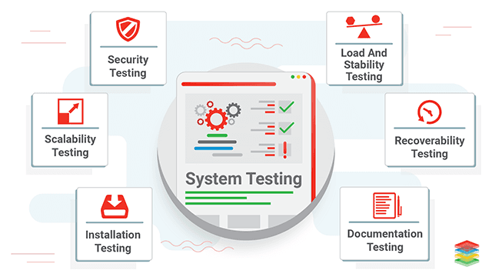
System tests
Similar to integration testing, but much broader in scope
Whereas integration testing focuses on whether the modules work together without error, system tests examine how well the system meets business requirements and its usability, security, and performance under heavy load
Also tests the systems documentation

Slide 32
Acceptance testing
Primarily done by the users with support from the project team
Confirms the system is complete, meets the business needs that prompted the system to be developed, and is acceptable to the users
Is done in two stages:
Alpha testing:
Users test the system using made-up data
Beta testing:
Users begin to test the system with real data and carefully monitor the system for errors

Slide 33
Developing documentation
System documentation is intended to help programmers and systems analysts understand the application software and enable them to build it or maintain it after the system is installed
Should be created as the project unfolds
This includes code comments, source control log etc.
User documentation (such as user manuals, training manuals, and online help systems) is designed to help the user operate the system
Producing documentation requires designing the documents (whether paper or online), writing the text, editing them, and testing them.

Slide 34
Types of user documentation
Reference documents:
are designed to be used when the user needs to learn how to perform a specific function
Typically read only after the user has tried and failed to perform the function
Requires special care because users are often impatient or frustrated when they begin to read them
Procedures manuals
Describe how to perform business tasks
Guides the user through a task that requires several functions or steps in the system.
Each entry is typically much longer than an entry in a reference document
Tutorials
Teach people how to use major components of the system
Longer still than the entries in procedures manuals

Slide 35
Next Lecture
Transition to the new system

